Slide 1


Youtube Songs analysis
By imane wiran

Slide 2

PRoblem statement :
This internship project aims to perform a comprehensive analysis of YouTube song data using Power BI. The dataset includes key attributes such as video ID, channel title, title, description, tags, published date, view count, like count, favorite count, comment count, video duration, video definition, and caption details. The objective is to use Power BI to create insightful visualizations and reports that provide a deeper understanding of the performance, popularity, and user engagement of YouTube songs. The analysis seeks to uncover trends, preferences, and patterns in the data to help content creators and stakeholders optimize their YouTube song content.

Slide 3
Dataset Description:
1. video_id: Unique identifier for each YouTube video.
2. channelTitle: Title of the YouTube channel publishing the song.
3. title: Title of the YouTube song video.
4. description: Description provided for the YouTube song video.
5. tags: Tags associated with the YouTube song video.
6. publishedAt: Date and time when the YouTube song video was published.
7. viewCount: Number of views received by the YouTube song video.
8. likeCount: Number of likes received by the YouTube song video.
9. favoriteCount: Number of times the YouTube song video has been marked as a favorite.
10. commentCount: Number of comments posted on the YouTube song video.
11. duration: Duration of the YouTube song video.
12. definition: Video definition or quality (e.g., HD, SD).
13. caption: Availability of captions for the YouTube song video.

Slide 4

Project Objectives:
1. Data Cleaning and Preparation:
Clean and preprocess the dataset, handling missing values or outliers.
Convert relevant columns to appropriate data types.
2. Exploratory Data Analysis (EDA):
Explore patterns and distributions in view counts, like counts, and comments.
Identify trends in the popularity and engagement of YouTube song videos.
3. Content and Channel Analysis:
Analyze the distribution of videos across different channels.
Identify popular tags and their correlation with view counts.
4. Temporal Trends:
Explore how YouTube song video metrics vary over time.
Identify peak publishing times and their impact on engagement.
5. User Engagement Insights:
Investigate relationships between likes, comments, and views.
Identify factors influencing user engagement with YouTube song videos.

Slide 5
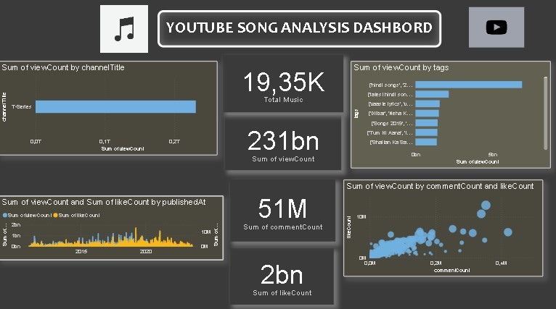
DASHBORD EXAMPLE

Slide 6
Recommendations for content creators and stakeholders to enhance YouTube song video performance.
1.Use Specific and Relevant Tags:Ensure that tags accurately reflect the content of the video and include popular and trending keywords to increase visibility.
2. Encourage Viewer Engagement:Videos that receive more comments and likes are more likely to be featured prominently on YouTube. Encourage viewers to engage by asking questions, prompting discussions, and actively responding to comments.
3. Publish at Optimal Times: Posting during peak hours when your target audience is most active can significantly enhance viewership.
4.Diversify Content: In addition to regular song videos, consider creating behind-the-scenes footage, interviews with artists, and other exclusive content. This variety keeps the audience engaged and encourages repeat visits to your channel.
5. Optimize Video Titles and Descriptions: Ensure that video titles and descriptions are compelling, clear, and include relevant keywords.

Slide 7


